Slide 1
Predicting Market Sentiment from Financial News Articles
MGT 6314 Team - 17
Manikant Thatipalli
Prasanthi Mounika Toram

Slide 2
Contents
Introduction
Text Data and Preprocessing
Exploratory Data Analysis
Algorithms and Modeling
Model Comparison
Conclusion and Future work

Slide 3
Introduction

Slide 4
Objective
Purpose:
To demonstrate how sentiment analysis of customer comments and financial news can effectively measure market sentiment, providing critical insights for financial decision-making.
Objective:
To explore and evaluate multiple sentiment analysis models to determine which most accurately captures market trends

Slide 5
Text Data and Preprocessing

Slide 6
Data :
Our analysis leverages the "Financial Sentiment Analysis" dataset, which contains 5,322 labeled financial sentences categorized as positive, negative, or neutral. This data includes detailed sentiment classifications essential for financial market analysis.
5,322 Unique Comments
Source : Financial Sentiment Analysis (kaggle.com)

Slide 7
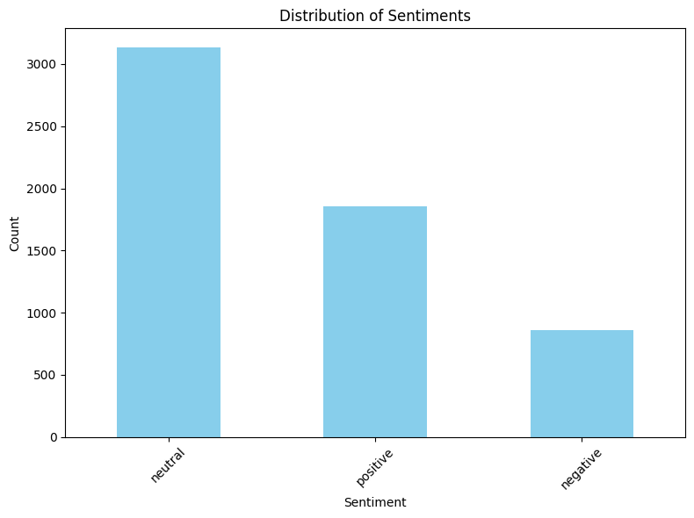
Distribution of different sentiments
We did observe a class imbalance in sentiments and thus accounted by choosing Macro F1 as an evaluation metric

Slide 8
Preprocessing
Text Preprocessing
Converting to lowercase
Removing Punctuations
Removing Stopwords
Lemmatization of each token
Vestibulum congue tempus

Slide 9
Exploratory Data Analysis

Slide 10

Master Word Cloud

Slide 11
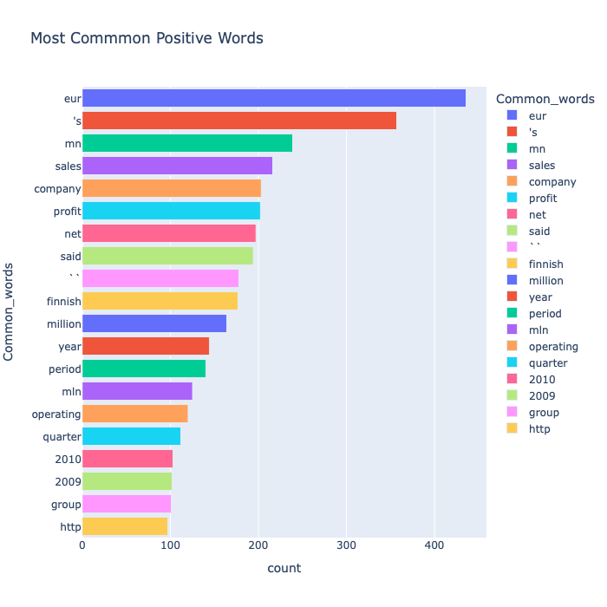
Most Common words in Positive Sentiment

Slide 12
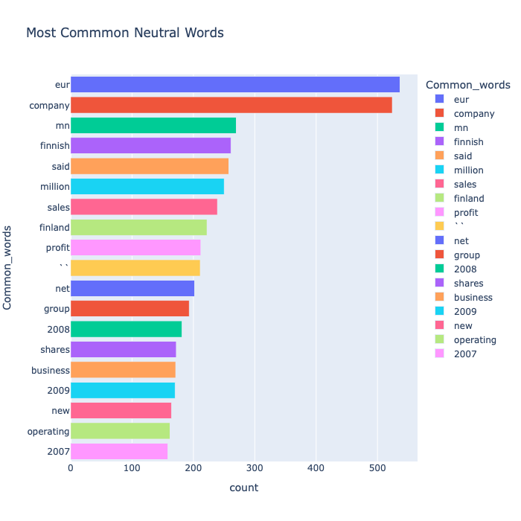
Most Common words in Neutral Sentiment

Slide 13
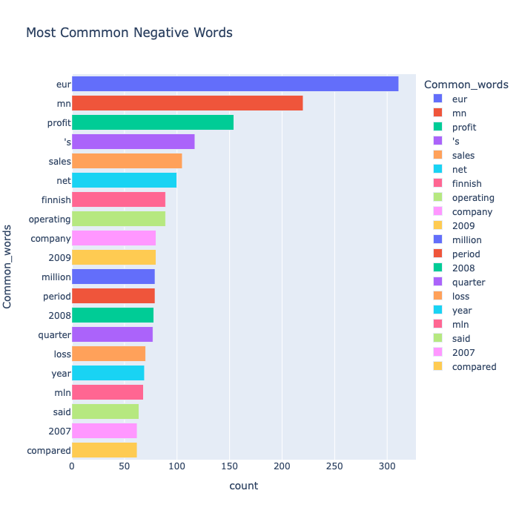
Most Common words in Negative Sentiment

Slide 14
Algorithms and Modeling

Slide 15
TFIDF Embedding
TF-IDF Overview : TF-IDF, short for Term Frequency-Inverse Document Frequency, is a numerical statistic used to evaluate the importance of words in a document relative to a collection of documents.
Vectorization : TF-IDF vectorization transforms text documents into numerical vectors, where each component represents the importance of a word in the document relative to the entire corpus.
Applications: TF-IDF is widely used in information retrieval systems for ranking search results, as well as in text classification tasks such as sentiment analysis and spam detection, due to its ability to capture the significance of terms within documents.

Slide 16
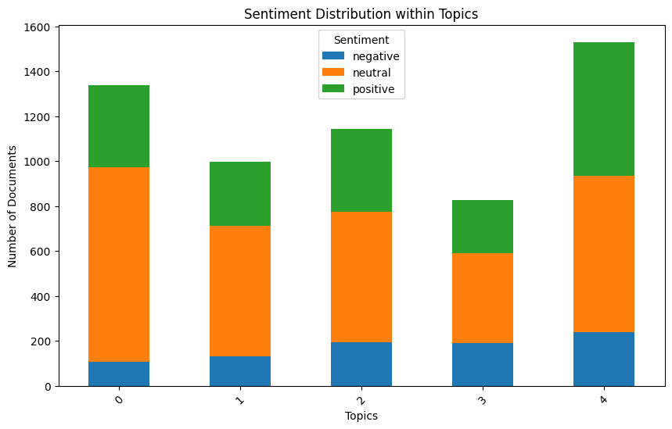
Topic modelling - LDA
Due to the similarity among comments, topic modeling could not give discriminative classes

Slide 17

Evaluation Metrics : Cross Validation and Macro F1
K-fold Cross-Validation : This is a more robust approach where the data is split into K folds, and each fold is used for testing once. The final performance metric is averaged across all folds.
Ensures the model learns generalizable patterns and avoids focusing on specific training data points.
Gives a reliable measure of how well the model will perform on unseen user data.
Macro F1 Score :

Slide 18
Model Comparison and Conclusion

Slide 19
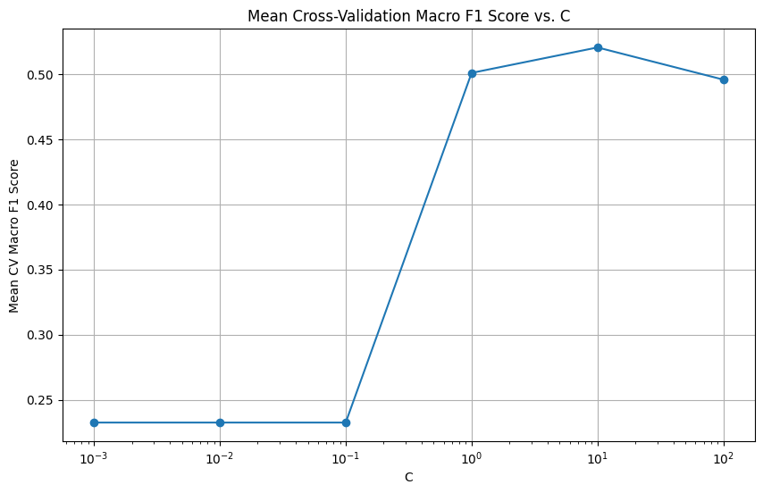
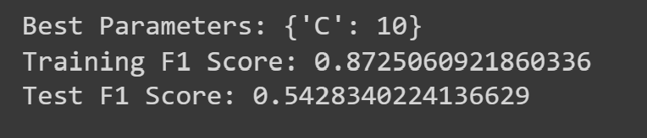
SVM Classification
C=10 | Macro F1 (On test)
Split-1 | 53.18
Split-2 | 51.67
Split-3 | 50.89
Split-4 | 53.12
Split-5 | 51.38

Slide 20
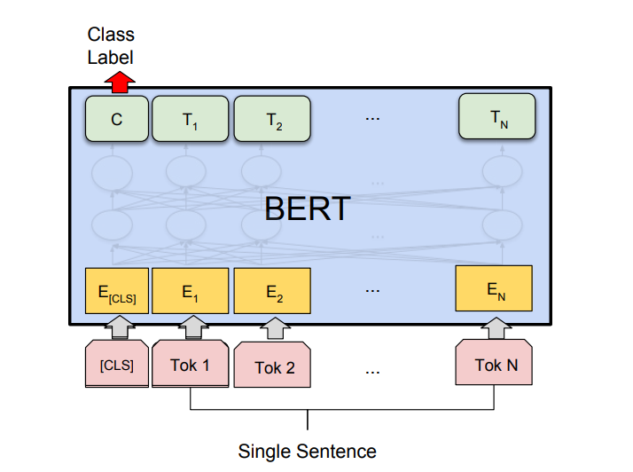
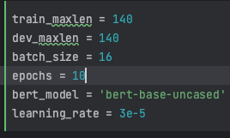
BERT Classification
Train Setting
Class | Precision | Recall | Macro F1 (On test)
Positive | 80 | 88.4 | 72.2
Neutral | 88 | 73
Negative | 45.4 | 63.3
We have considered bert-base-uncased pretrained model, with a dropout and a linear layer at the end to produce 3 labels.
Notes:
BERT offers a promising solution by understanding the contextual subtleties of text, making it well-suited for sentiment classification tasks.

Slide 21
Conclusion and Future Scope
Conclusion :
BERT performs better than SVM for this data, because it better captures the intricacies involved in context and semantics within the texts.
72.2 (BERT) vs 52 (SVM)
Future Scope :
Scaling the solution to a production-level product, prioritizing robustness.
Enabling real-time market sentiment tracking from financial news sources.

Slide 22
Thank You

